Slide 1
DASC 5301-002
Decision Tree
Dr Subharag Sarkar
Fall 2023
Slides Courtesy - Rózsa Záruba

Slide 2
Decision Tree
A decision tree is a non-parametric supervised learning algorithm for classification and regression tasks.
It has a hierarchical tree structure consisting of a root node, branches, internal nodes, and leaf nodes.
Decision trees are used for classification and regression tasks, providing easy-to-understand models.

Slide 3

Decision Tree
A decision tree is a hierarchical model used in decision support that depicts decisions and their potential outcomes.
This algorithmic model utilizes conditional control statements and is non-parametric, supervised learning, useful for both classification and regression tasks.
The tree structure is comprised of a root node, branches, internal nodes, and leaf nodes, forming a hierarchical, tree-like structure
Notes:
After first point - > incorporating chance events, resource expenses, and utility.

Slide 4
Decision Tree
It is a tool that has applications spanning several different areas.
Decision trees can be used for classification as well as regression problems.
The name itself suggests that it uses a flowchart like a tree structure to show the predictions that result from a series of feature-based splits.
It starts with a root node and ends with a decision made by leaves.

Slide 5
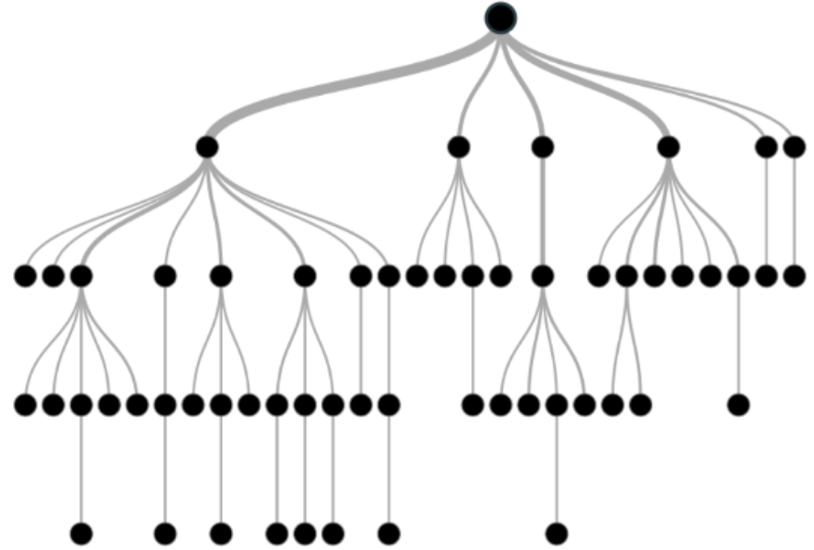

Slide 6
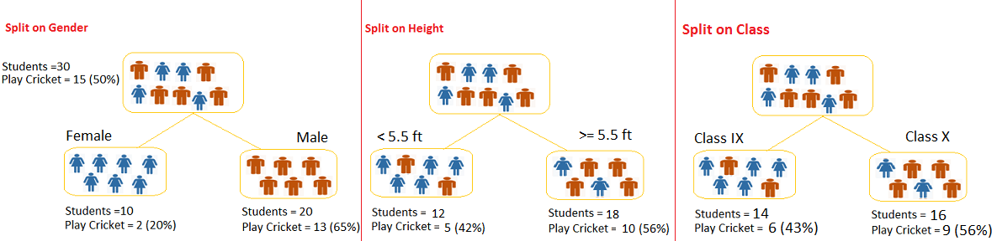

Slide 7
Types of Decision Tree
Categorical Variable Decision Tree:
A Decision Tree that has a categorical target variable is called a categorical variable decision tree.
Example: let’s say the target variable was “Student will play cricket or not” i.e. YES or NO.
Continuous Variable Decision Tree:
If the decision tree has a continuous target variable then it is called a Continuous Variable Decision Tree.

Slide 8
Decision Tree Terminologies
Notes:
Before learning more about decision trees let’s get familiar with some of the terminologies:

Slide 9
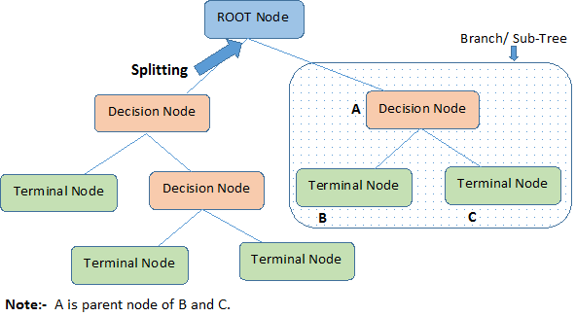
Decision Tree Terminologies
Root Node: The initial node at the beginning of a decision tree, where the entire population or dataset starts dividing based on various features or conditions.
Splitting: It is a process of dividing a node into two or more sub-nodes.
Decision Nodes: Nodes resulting from the splitting of root nodes are known as decision nodes. These nodes represent intermediate decisions or conditions within the tree.

Slide 10
Decision Tree Terminologies
Leaf Nodes: Nodes where further splitting is not possible, often indicating the final classification or outcome. Leaf nodes are also referred to as terminal nodes.
Sub-Tree: Similar to a subsection of a graph being called a sub-graph, a sub-section of a decision tree is referred to as a sub-tree. It represents a specific portion of the decision tree.
Pruning: The process of removing or cutting down specific nodes in a decision tree to prevent overfitting and simplify the model.

Slide 11
Decision Tree Terminologies
Branch / Sub-Tree: A subsection of the entire decision tree is referred to as a branch or sub-tree. It represents a specific path of decisions and outcomes within the tree.
Parent and Child Node: In a decision tree, a node that is divided into sub-nodes is known as a parent node, and the sub-nodes emerging from it are referred to as child nodes. The parent node represents a decision or condition, while the child nodes represent the potential outcomes or further decisions based on that condition

Slide 12
Building a Decision Tree

Slide 13
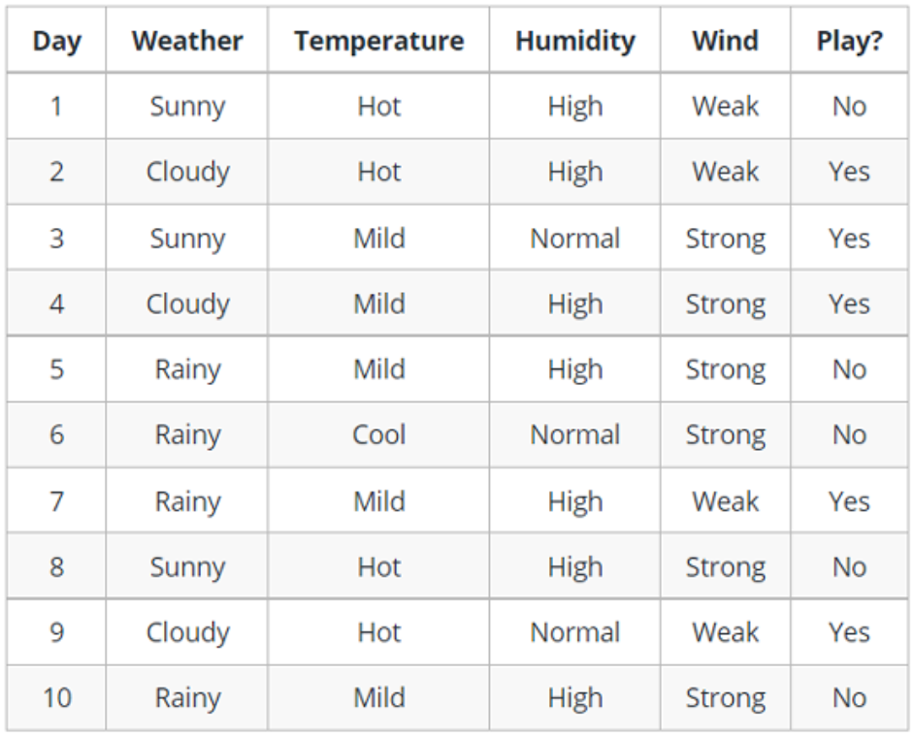
Notes:
Let’s understand decision trees with the help of an example:
Decision trees are upside down which means the root is at the top and then this root is split into various several nodes. Decision trees are nothing but a bunch of if-else statements in layman terms. It checks if the condition is true and if it is then it goes to the next node attached to that decision.

Slide 14
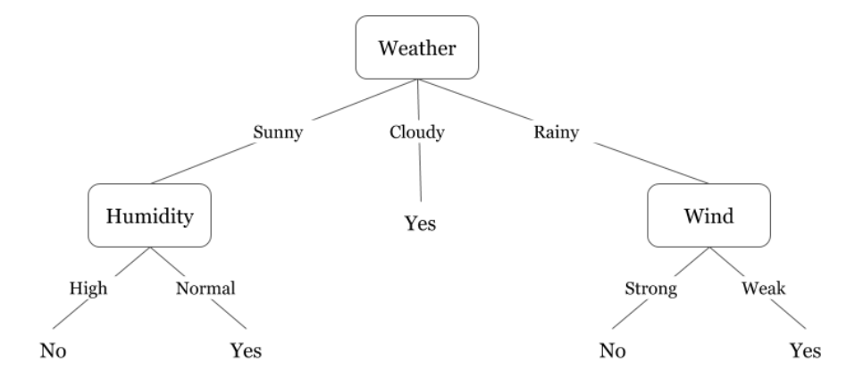
Notes:
In the below diagram the tree will first ask what is the weather? Is it sunny, cloudy, or rainy? If yes then it will go to the next feature which is humidity and wind. It will again check if there is a strong wind or weak, if it’s a weak wind and it’s rainy then the person may go and play.

Slide 15
Building a Decision Tree
Did you notice anything in the above flowchart?
We see that if the weather is cloudy then we must go to play.
Why didn’t it split more?
Why did it stop there?

Slide 16
Building a Decision Tree
To answer this question, we need to know about a few more concepts like entropy, information gain, and the Gini index.
But in simple terms, we can say here that the output for the training dataset is always yes for cloudy weather, since there is no disorderliness here we don’t need to split the node further.

Slide 17
Entropy

Slide 18
Entropy
Entropy is nothing but the uncertainty in our dataset or measure of disorder.
Decision trees use Entropy to measure the impurity of the node.
Impurity is the degree of randomness; it tells how random our data is.

Slide 19
Entropy
Suppose a group of friends is trying to decide which movie they can watch together on Sunday.
There are 2 choices for movies, one is “Lucy” and the second is “Titanic” and now everyone has to tell their choice.
After everyone gives their answer we see that “Lucy” gets 4 votes and “Titanic” gets 5 votes.
Which movie do they watch now?
Isn’t it hard to choose 1 movie now because the votes for both movies are somewhat equal?

Slide 20
Entropy
This is exactly what is called disorderness, there is an equal number of votes for both movies, and we can’t really decide which movie we should watch.
It would have been much easier if the votes for “Lucy” were 8 and for “Titanic” it was 2.
Here we could easily say that the majority of votes are for “Lucy” hence everyone will be watching this movie.
In a decision tree, the output is mostly “yes” or “no”

Slide 21

Entropy
The formula for Entropy is shown
p₊ is the probability of positive class
p₋ is the probability of negative class
S is the subset of the training example

Slide 22
How Decision Trees use Entropy
Now we know what entropy is and what is its formula.
Next, we need to know how exactly it works in this algorithm.
Entropy basically measures the impurity of a node.
Impurity is the degree of randomness; it tells how random our data is.
A pure sub-split means that either you should be getting “yes”, or you should be getting “no”.

Slide 23
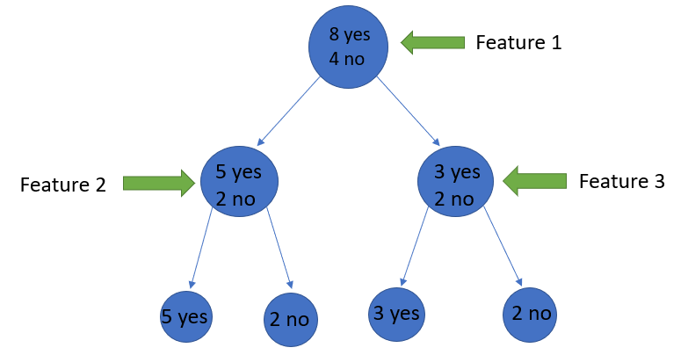
Entropy
Suppose a feature has 8 “yes” and 4 “no” initially, after the first split the left node gets 5 ‘yes’ and 2 ‘no’ whereas the right node gets 3 ‘yes’ and 2 ‘no’.
The split is not pure, why?
Because we can still see some negative classes in both nodes.
In order to make a decision tree, we need to calculate the impurity of each split, and when the purity is 100%, we make it as a leaf node.
Notes:
End with -> To check the impurity of feature 2 and feature 3 we will take the help for Entropy formula.

Slide 24
How to build Decision Trees

Slide 25
How to build Decision Trees
While building a Decision tree, the main thing is to select the best attribute from the total features list of the dataset for the root node as well as for sub-nodes.
The selection of best attributes is achieved with the help of a technique known as the Attribute selection measure (ASM).
With the help of ASM, we can easily select the best features for the respective nodes of the decision tree.
There are two techniques for ASM:
a) Information Gain
b) Gini Index

Slide 26
Information Gain

Slide 27
Information Gain
Information gain measures the reduction of uncertainty given some feature and it is also a deciding factor for which attribute should be selected as a decision node or root node.
It is just the entropy of the full dataset – the entropy of the dataset given some feature.

Slide 28
Information Gain
It tells how much information a feature/attribute provides us.
Following the value of the information gain, splitting of the node and decision tree building is being done.
Decision tree always tries to maximize the value of the information gain, and a node/attribute having the highest value of the information gain is being split first.

Slide 29
Information Gain
Suppose our entire population has a total of 30 instances.
The dataset is to predict whether the person will go to the gym or not.
Let’s say 16 people go to the gym and 14 people don’t.
Now we have two features to predict whether he/she will go to the gym or not.
Feature 1 is “Energy” which takes two values “high” and “low”
Feature 2 is “Motivation” which takes 3 values “No motivation”, “Neutral” and “Highly motivated”.
Notes:
Begin -> To understand this better let’s consider an example:
End-> Let’s see how our decision tree will be made using these 2 features.
We’ll use information gain to decide which feature should be the root node and which feature should be placed after the split.

Slide 30
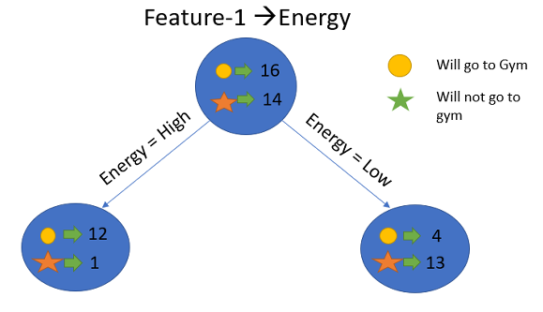
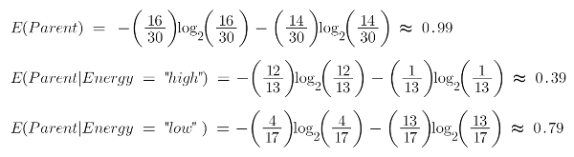
Feature 1
Let’s Calculate the Entropy:

Slide 31
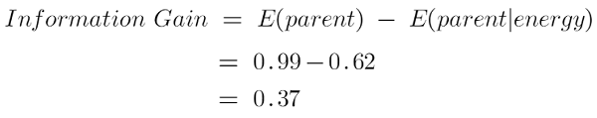
Feature 1
Now calculate the weighted average of entropy of each node.
Now we have the value of E(Parent) and E(Parent|Energy), information gain will be:
Our parent entropy was near 0.99 and after looking at this value of information gain, we can say that the entropy of the dataset will decrease by 0.37 if we make “Energy” as our root node.

Slide 32
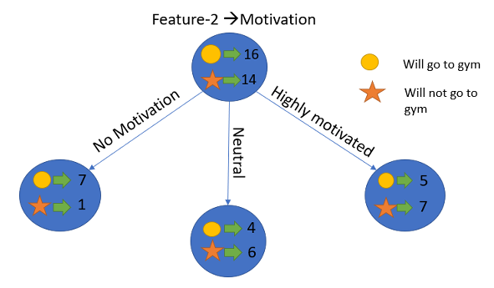
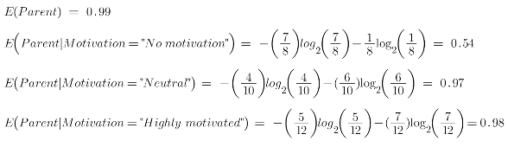
Feature 2
Let us Calculate the entropy here:
Notes:
Similarly we will do this for the other feature and calculate the Information gain

Slide 33
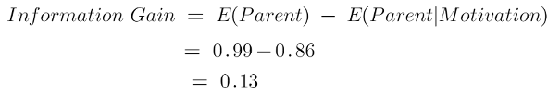
Feature 2
Now calculate the weighted average of entropy of each node.
Now we have the value of E(Parent) and E(Parent|Energy), information gain will be:
Our parent entropy was near 0.99 and after looking at this value of information gain, we can say that the entropy of the dataset will decrease by 0.13 if we make “Motivation” our root node.

Slide 34
Information Gain
We now see that the “Energy” feature gives more reduction which is 0.37 than the “Motivation” feature.
Hence, we will select the feature that has the highest information gain and then split the node based on that feature.
In this example “Energy” will be our root node and we’ll do the same for sub-nodes.
Here we can see that when the energy is “high” the entropy is low and hence we can say a person will definitely go to the gym if he has high energy, but what if the energy is low?
We will again split the node based on the new feature which is “Motivation”.

Slide 35
Gini Index

Slide 36
Gini Index
Gini index is also being defined as a measure of impurity/ purity used while creating a decision tree in the CART(Classification and Regression Tree) algorithm.
An attribute having a low Gini index value should be preferred in contrast to the high Gini index value.
It only creates binary splits, and the CART algorithm uses the Gini index to create binary splits.
Gini index can be calculated using the below formula:
Gini Index= 1- ∑_{j}P_{j}²
Where pj stands for the probability

Slide 37
When to stop splitting

Slide 38
When to stop Splitting
You must be asking this question to yourself that when do we stop growing our tree?
Usually, real-world datasets have a large number of features, which will result in a large number of splits, which in turn gives a huge tree
Such trees take time to build and can lead to overfitting.
That means the tree will give very good accuracy on the training dataset but will give bad accuracy in test data.

Slide 39
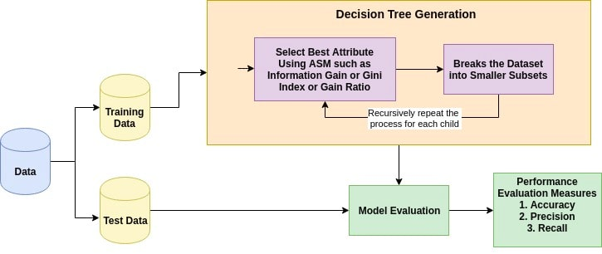
When to stop Splitting
The basic idea behind any decision tree algorithm is as follows:
Select the best Feature using Attribute Selection Measures(ASM) to split the records.
Make that attribute/feature a decision node and break the dataset into smaller subsets.
Start the tree-building process by repeating this process recursively for each child until one of the following condition is being achieved :
a) All tuples belonging to the same attribute value.
b) There are no more of the attributes remaining.
c ) There are no more instances remaining.

Slide 40
When to stop Splitting
max_depth:
The higher the value, the more complex your tree will be.
The training error will off-course decrease if we increase the max_depth value but when our test data comes into the picture, we will get a very bad accuracy.
min_samples_split:
We specify the minimum number of samples required to do a split..

Slide 41
When to stop Splitting
min_samples_leaf:
Represents the minimum number of samples required to be in the leaf node.
The more you increase the number, the more is the possibility of overfitting.
max_features:
It helps us decide what number of features to consider when looking for the best split

Slide 42
Pruning

Slide 43
Pruning
Pruning is another method that can help us avoid overfitting.
It helps in improving the performance of the tree by cutting the nodes or sub-nodes that are not significant.
Additionally, it removes the branches which have very low importance.

Slide 44
Pruning
There are mainly 2 ways for pruning:
Pre-pruning – we can stop growing the tree earlier, which means we can prune/remove/cut a node if it has low importance while growing the tree.
Post-pruning – once our tree is built to its depth, we can start pruning the nodes based on their significance.

Slide 45
Advantages of Decision Tree
Easy to Understand:
Decision tree output is very easy to understand even for people from non-analytical backgrounds.
It does not require any statistical knowledge to read and interpret them.
Its graphical representation is very intuitive and users can easily relate their hypothesis.

Slide 46
Advantages of Decision Tree
Useful in Data exploration:
Decision tree is one of the fastest ways to identify the most significant variables and the relation between two or more variables.
With the help of decision trees, we can create new variables/features that have better power to predict target variable.

Slide 47
Advantages of Decision Tree
Fewer data cleaning required:
It requires less data cleaning compared to some other modeling techniques.
It is not influenced by outliers and missing values to a fair degree.
Data type is not a constraint:
It can handle both numerical and categorical variables.
Non-Parametric Method:
Decision tree is considered to be a non-parametric method.
This means that decision trees have no assumptions about the space distribution and the classifier structure.

Slide 48
Disadvantages of Decision Tree
Overfitting:
Overfitting is one of the most practical difficulties for decision tree models.
This problem is solved by setting constraints on model parameters and pruning (discussed in detail below).
Not fit for continuous variables:
While working with continuous numerical variables, decision tree loses information when it categorizes variables in different categories.

Slide 49
References
https://www.analyticsvidhya.com/blog/2021/08/decision-tree-algorithm/

